Slide 1
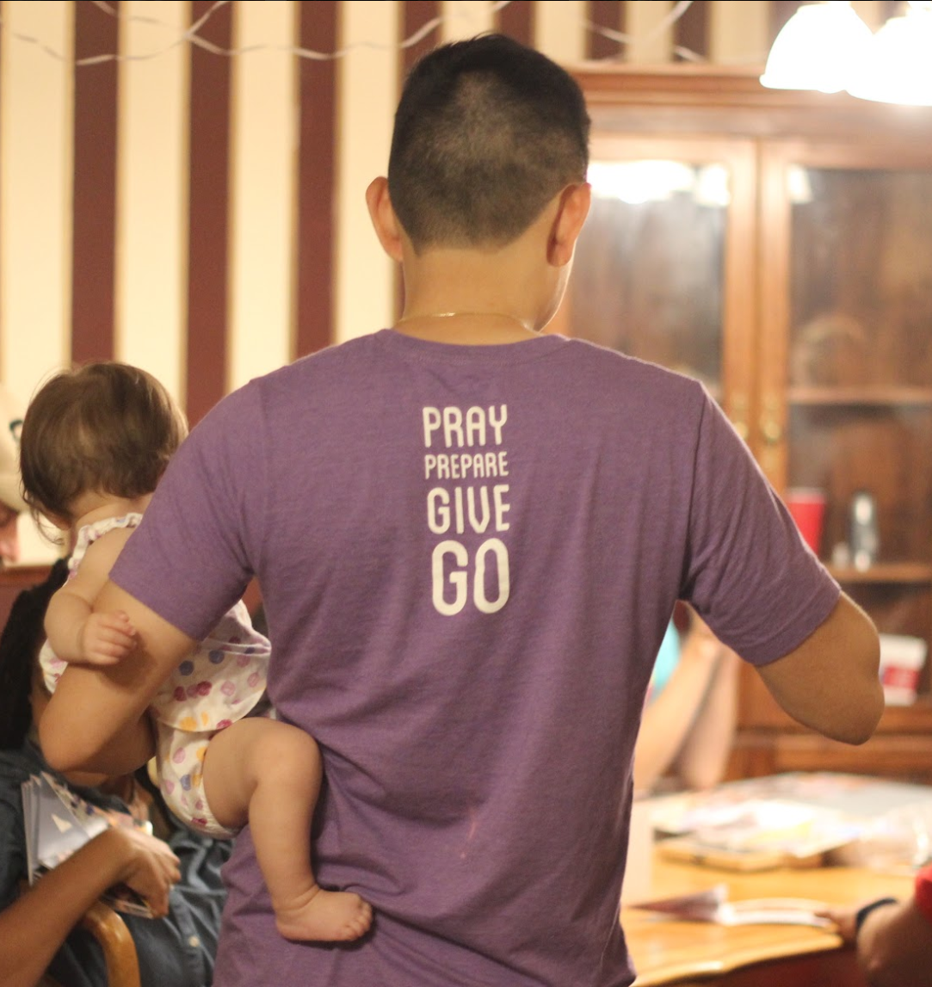
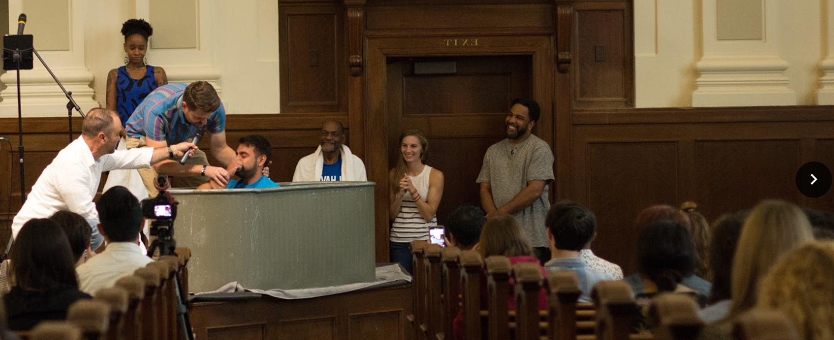

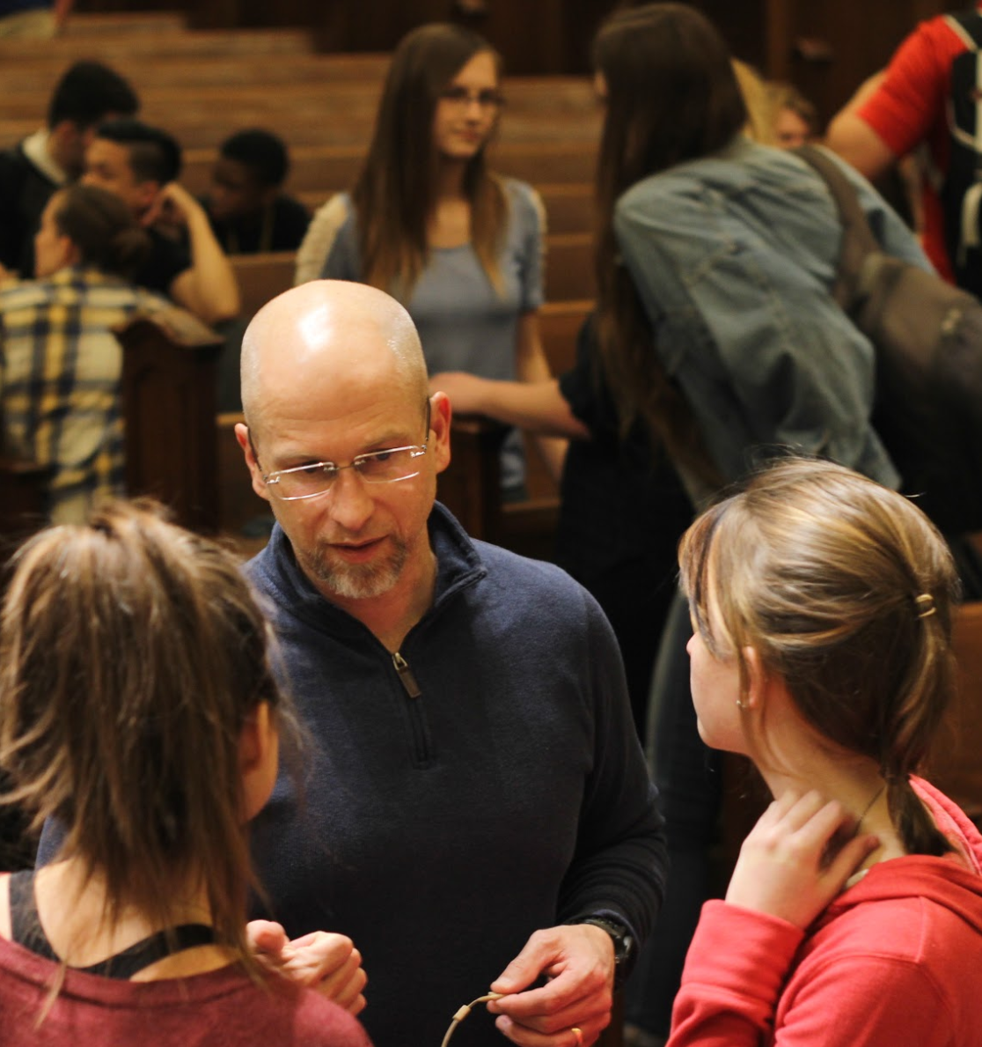



Hebrews 13
Pondering and Praying Over Our Pastors

Slide 2
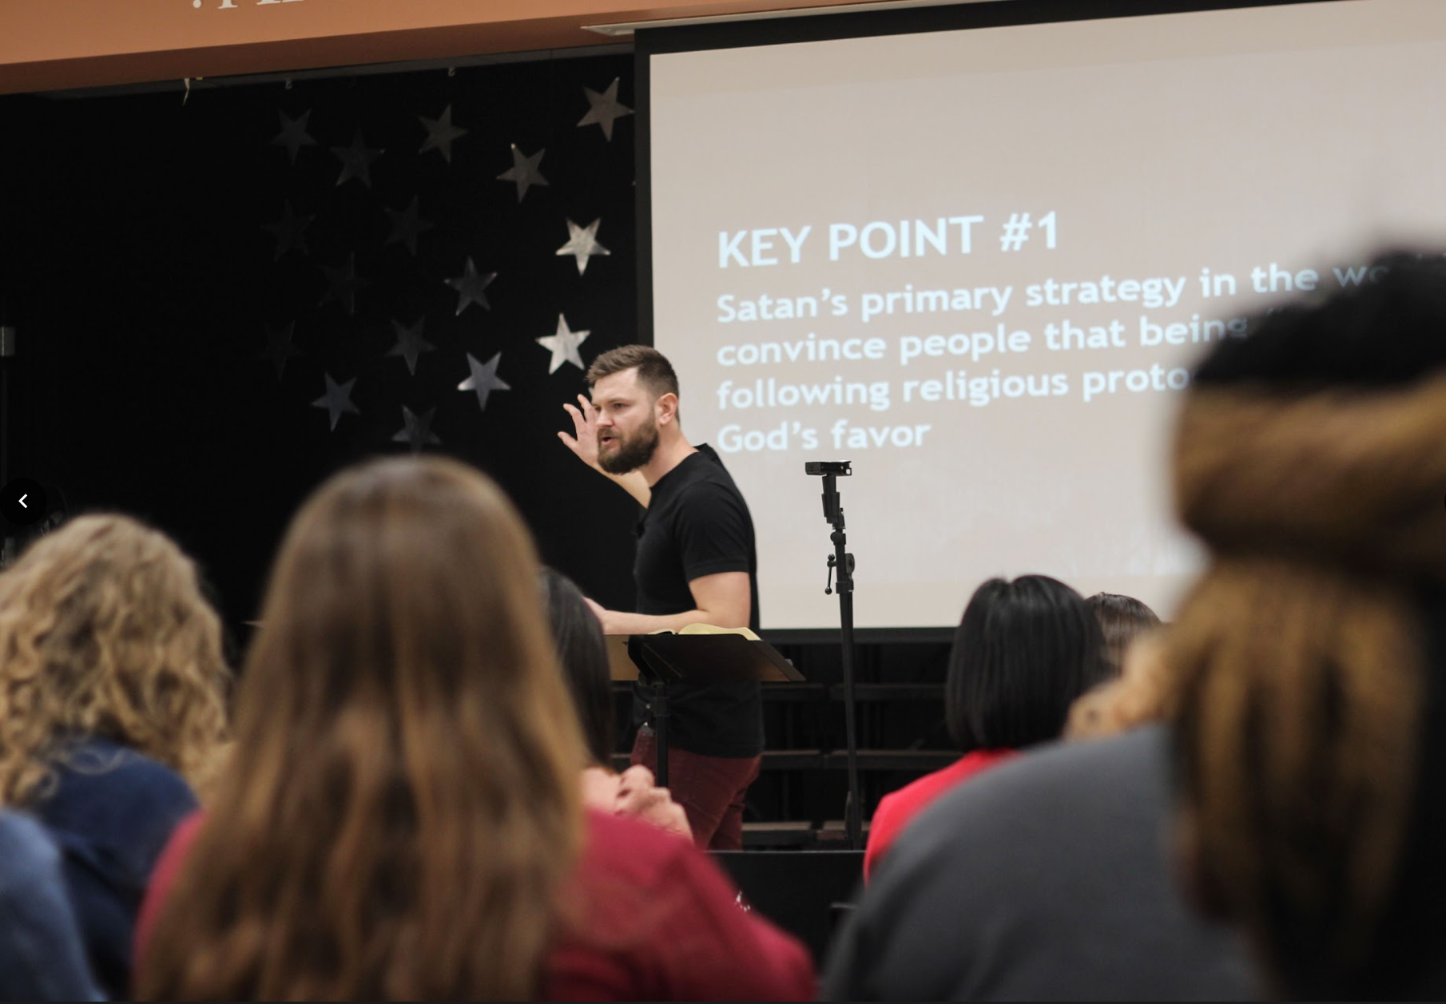
I. Vs 7: Remember

Slide 3
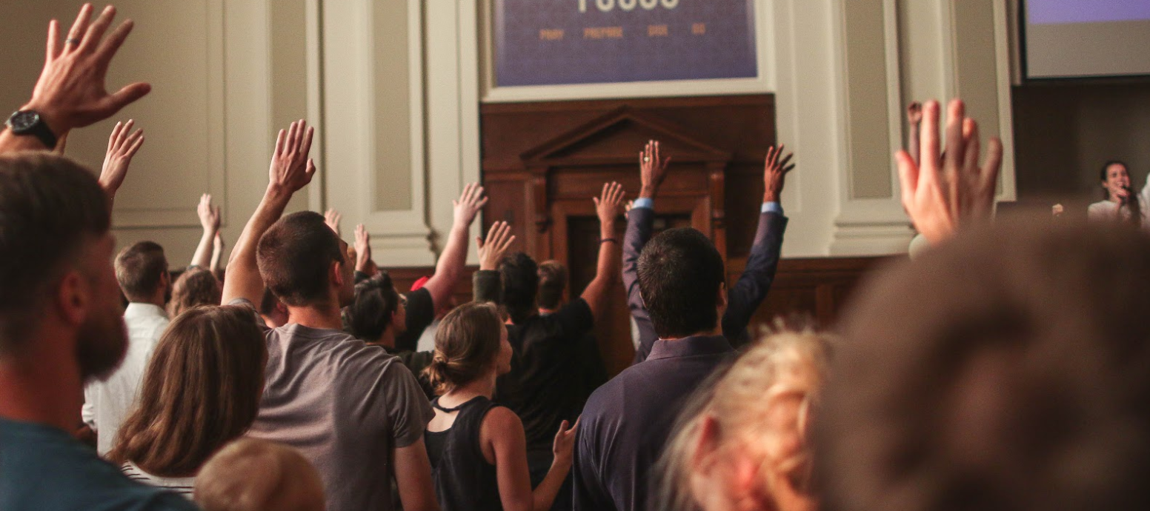
Video slide
2 Peter 1:8 For if these things be in you, and abound, they make you that ye shall neither be barren nor unfruitful in the knowledge of our Lord Jesus Christ.
2 Peter 1:12-15 Wherefore I will not be negligent to put you always in remembrance of these things, though ye know them, and be established in the present truth. 13 Yea, I think it meet, as long as I am in this tabernacle, to stir you up by putting you in remembrance; 14 Knowing that shortly I must put off this my tabernacle, even as our Lord Jesus Christ hath shewed me. 15 Moreover I will endeavour that ye may be able after my decease to have these things always in remembrance.

Slide 4
I. Vs 7: Remember
Pastors, future pastors – Beware!
James 3:1 My brethren, be not many masters, knowing that we shall receive the greater condemnation.
Hebrews 13:7b – Teach it right.
Acts 20:27 For I have not shunned to declare unto you all the counsel of God.

Slide 5
Video slide
1 Timothy 4:6-10 If thou put the brethren in remembrance of these things, thou shalt be a good minister of Jesus Christ, nourished up in the words of faith and of good doctrine, whereunto thou hast attained. 7 But refuse profane and old wives' fables, and exercise thyself rather unto godliness. 8 For bodily exercise profiteth little: but godliness is profitable unto all things, having promise of the life that now is, and of that which is to come.
9 This is a faithful saying and worthy of all acceptation. 10 For therefore we both labour and suffer reproach, because we trust in the living God, who is the Saviour of all men, specially of those that believe.

Slide 6
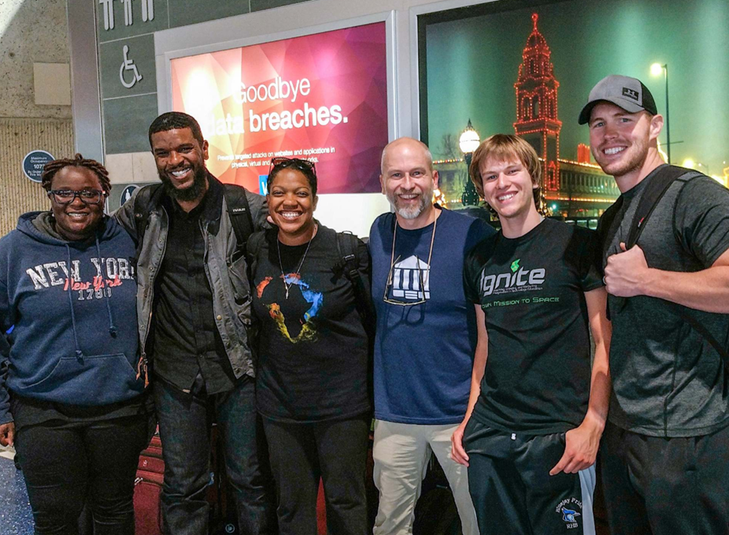
II. Follow.

Slide 7
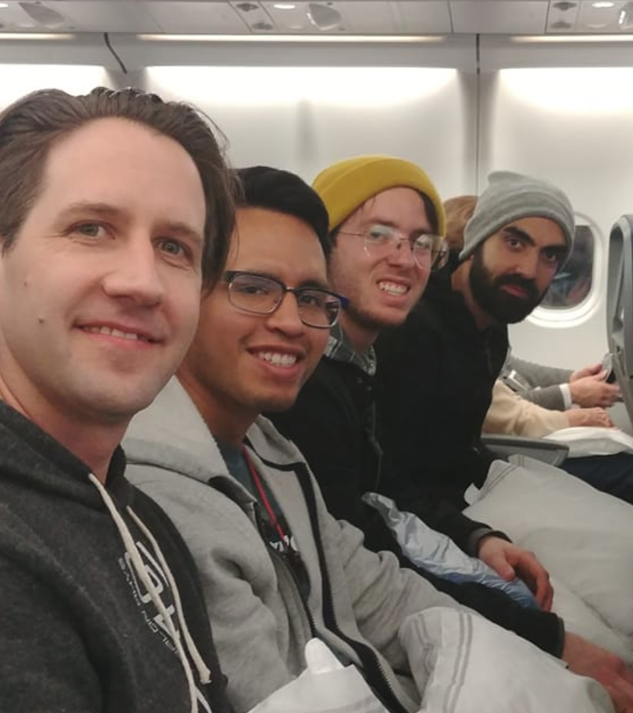
Video slide
Hebrews 6:12 That ye be not slothful, but
followers of them who through faith and
patience inherit the promises.
1 Corinthians 4:16 Wherefore I beseech you,
be ye followers of me.
1 Thessalonians 1:6-8 And ye became
followers of us, and of the Lord, having
received the word in much affliction, with
joy of the Holy Ghost: 7 So that ye were
ensamples to all that believe in Macedonia
and Achaia. 8 For from you sounded out the word of the Lord not only in Macedonia and Achaia, but also in every place your faith to God-ward is spread abroad; so that we need not to speak any thing.

Slide 8
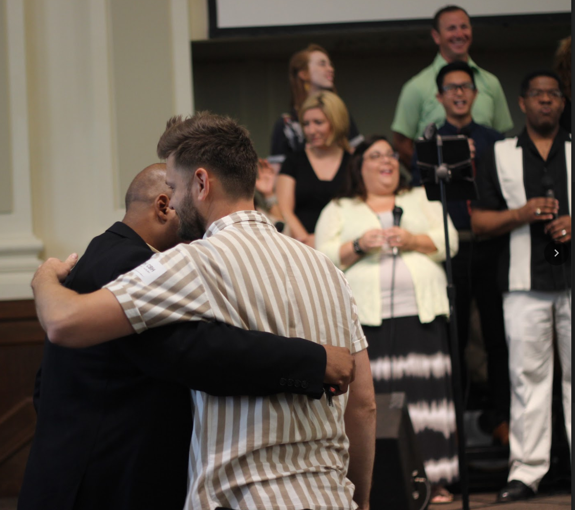
Video slide
2 Thessalonians 3:7-9 For yourselves know how ye ought to follow us: for we behaved not ourselves disorderly among you; 8 Neither did we eat any man's bread for nought; but wrought with labour and travail night and day, that we might not be chargeable to any of you: 9 Not because we have not power, but to make ourselves an ensample unto you to follow us.

Slide 9
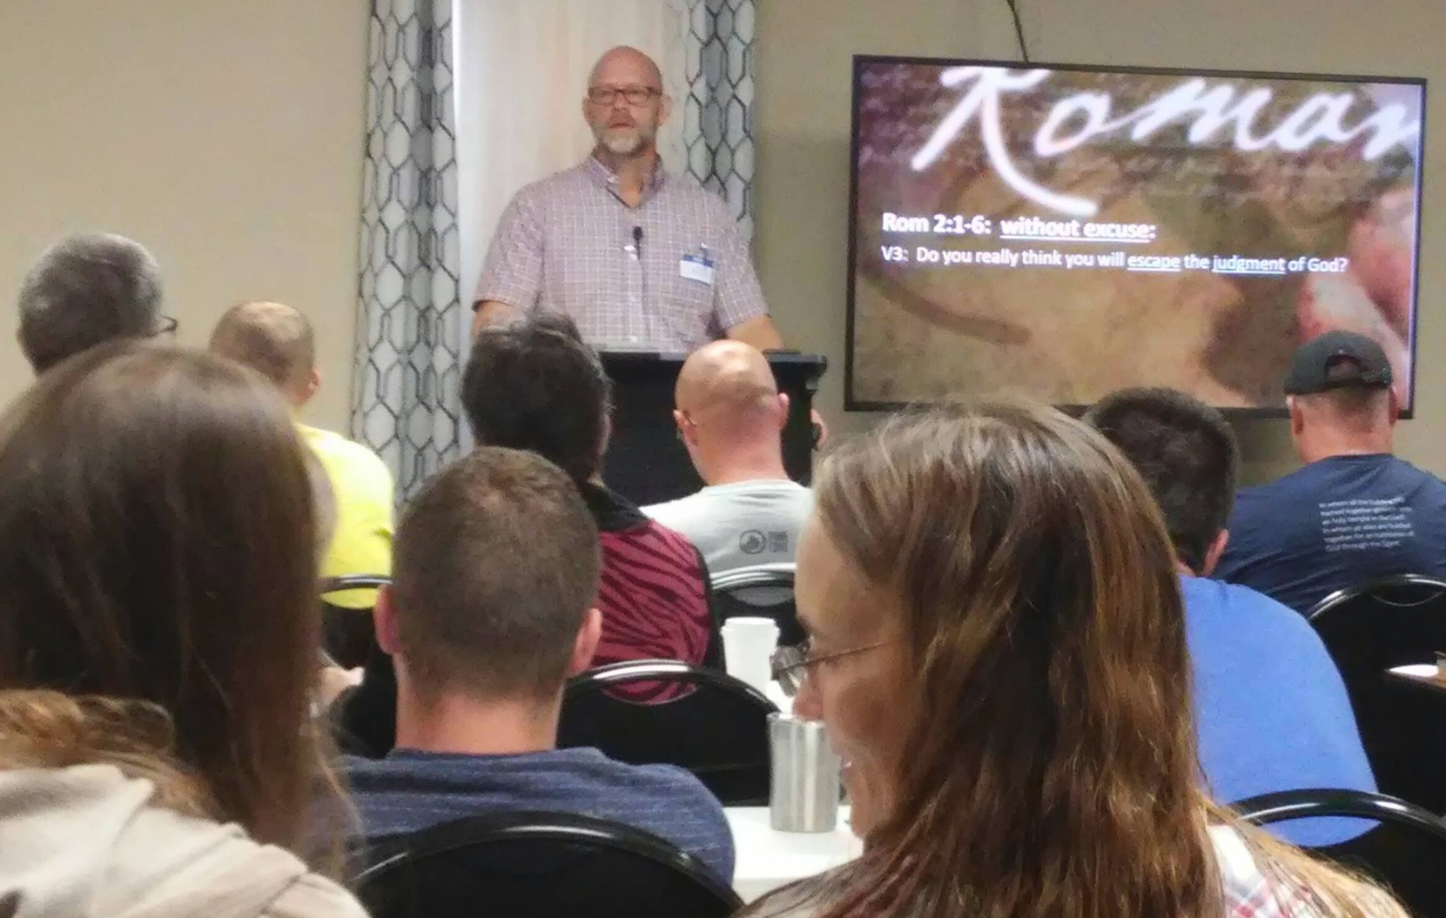
II. Follow
Follow what?
Is your pastor promoting HIS will
or GOD’S Word?
Don’t follow a hireling.
Pastors must be qualified.

Slide 10
Video slide
1 Timothy 3:1-7 This is a true saying, If a man desire the office of a bishop, he desireth a good work. 2 A bishop then must be blameless, the husband of one wife, vigilant, sober, of good behaviour, given to hospitality, apt to teach; 3 Not given to wine, no striker, not greedy of filthy lucre; but patient, not a brawler, not covetous; 4 One that ruleth well his own house, having his children in subjection with all gravity; 5 (For if a man know not how to rule his own house, how shall he take care of the church of God?) 6 Not a novice, lest being lifted up with pride he fall into the condemnation of the devil. 7 Moreover he must have a good report of them which are without; lest he fall into reproach and the snare of the devil.

Slide 11
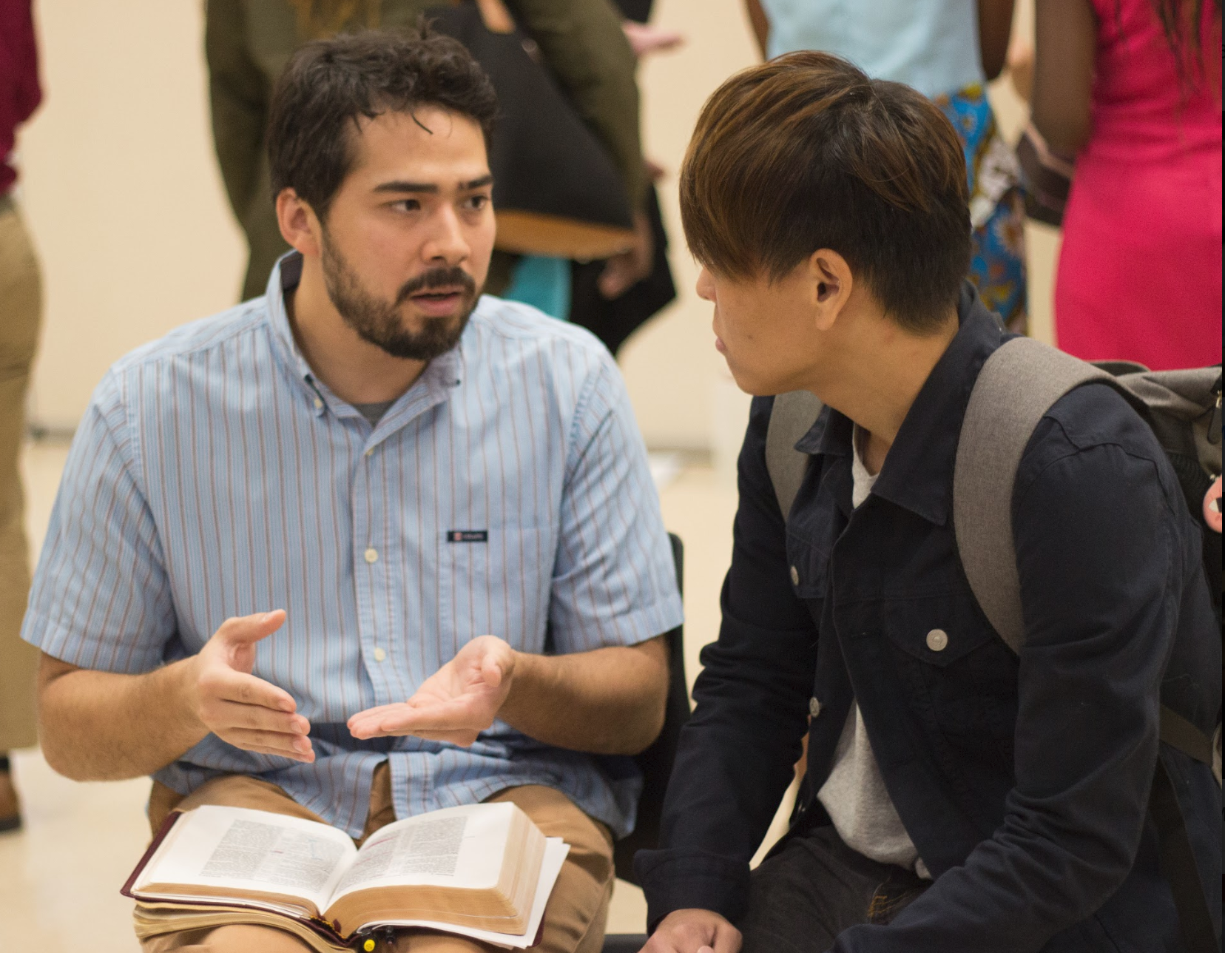
III. Obey.
This presupposes a rule of the Word.
Philippians 4:9 Those things, which
ye have both learned, and received,
and heard, and seen in me, do: and
the God of peace shall be with you.
Submit.

Slide 12
Video slide
Philippians 3:17-20 Brethren, be followers together of me, and mark them which walk so as ye have us for an ensample. 18 (For many walk, of whom I have told you often, and now tell you even weeping, that they are the enemies of the cross of Christ: 19 Whose end is destruction, whose God is their belly, and whose glory is in their shame, who mind earthly things.) 20 For our conversation is in heaven; from whence also we look for the Saviour, the Lord Jesus Christ:
1 Corinthians 4:14-16 I write not these things to shame you, but as my beloved sons I warn you. 15 For though ye have ten thousand instructors in Christ, yet have ye not many fathers: for in Christ Jesus I have begotten you through the gospel. 16 Wherefore I beseech you, be ye followers of me.

Slide 13
Video slide
Ephesians 5:21 Submitting yourselves one to another in the fear of God.
1 Peter 5:5 Likewise, ye younger, submit yourselves unto the elder. Yea, all of you be subject one to another, and be clothed with humility: for God resisteth the proud, and giveth grace to the humble.
Jeremiah 6:17 Also I set watchmen over you, saying, Hearken to the sound of the trumpet. But they said, We will not hearken.

Slide 14
Video slide
1 Timothy 5:1 Rebuke not an elder, but intreat him as a father; and the younger men as brethren;
1 Timothy 5:17-22 Let the elders that rule well be counted worthy of double honour, especially they who labour in the word and doctrine.
18 For the scripture saith, Thou shalt not muzzle the ox that treadeth out the corn. And, The labourer is worthy of his reward. 19 Against an elder receive not an accusation, but before two or three witnesses. 20 Them that sin rebuke before all, that others also may fear. 21 I charge thee before God, and the Lord Jesus Christ, and the elect angels, that thou observe these things without preferring one before another, doing nothing by partiality. 22 Lay hands suddenly on no man, neither be partaker of other men's sins: keep thyself pure.

Slide 15
Pastors beware!
James 3:1 My brethren, be not many masters, knowing that we shall receive the greater condemnation.
1 Timothy 4:1-6 Now the Spirit speaketh expressly, that in the latter times some shall depart from the faith, giving heed to seducing spirits, and doctrines of devils; 2 Speaking lies in hypocrisy; having their conscience seared with a hot iron; 3 Forbidding to marry, and commanding to abstain from meats, which God hath created to be received with thanksgiving of them which believe and know the truth. 4 For every creature of God is good, and nothing to be refused, if it be received with thanksgiving: 5 For it is sanctified by the word of God and prayer. 6 If thou put the brethren in remembrance of these things, thou shalt be a good minister of Jesus Christ, nourished up in the words of faith and of good doctrine, whereunto thou hast attained.

Slide 16
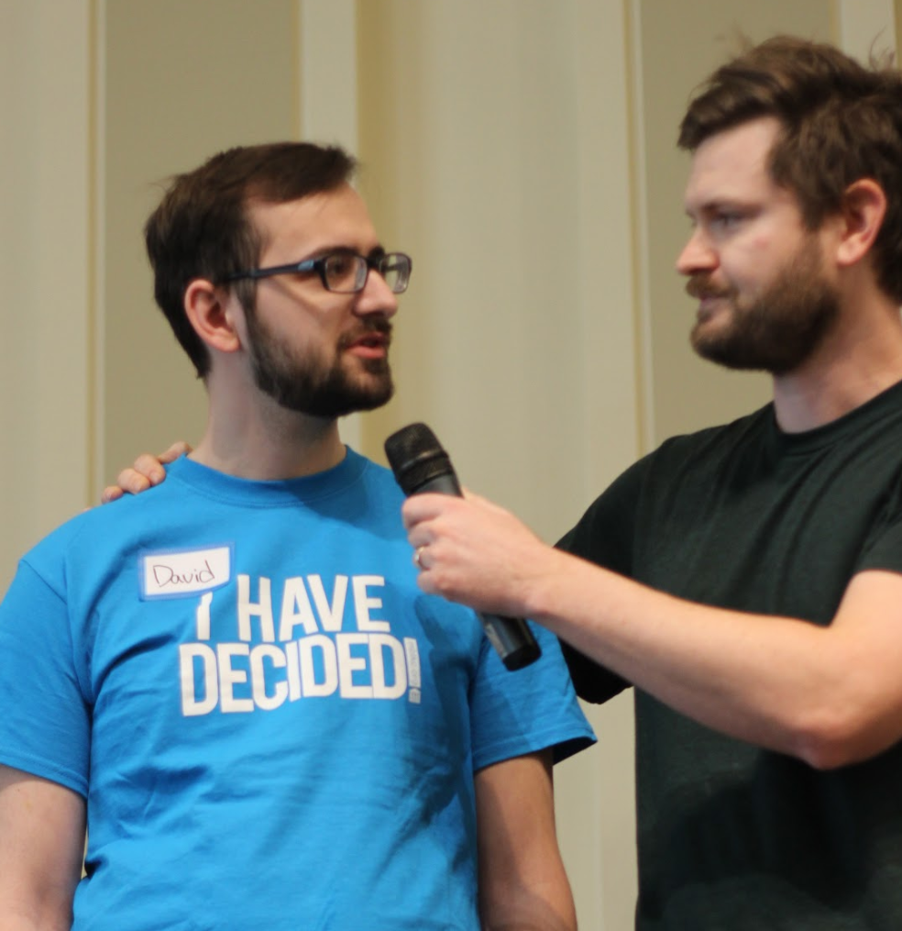
Video slide
Philippians 2:15-16 That ye may be blameless and harmless, the sons of God, without rebuke, in the midst of a crooked and perverse nation, among whom ye shine as lights in the world; 16 Holding forth the word of life; that I may rejoice in the day of Christ, that I have not run in vain, neither laboured in vain.

Slide 17
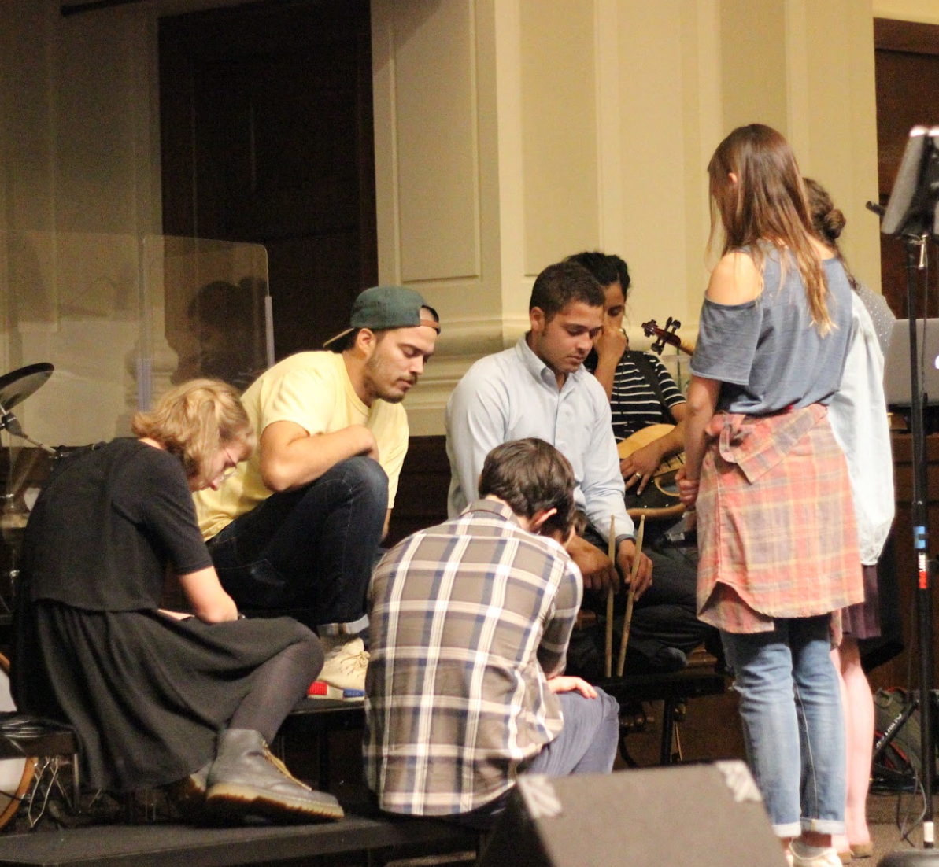
IV. Pray!
Right living.
Regular fellowship.
1 Thessalonians 5:25 Brethren, pray for us.
2 Thessalonians 3:1 Finally, brethren, pray for us, that the word of the Lord may have free course, and be glorified, even as it is with you:

Slide 18
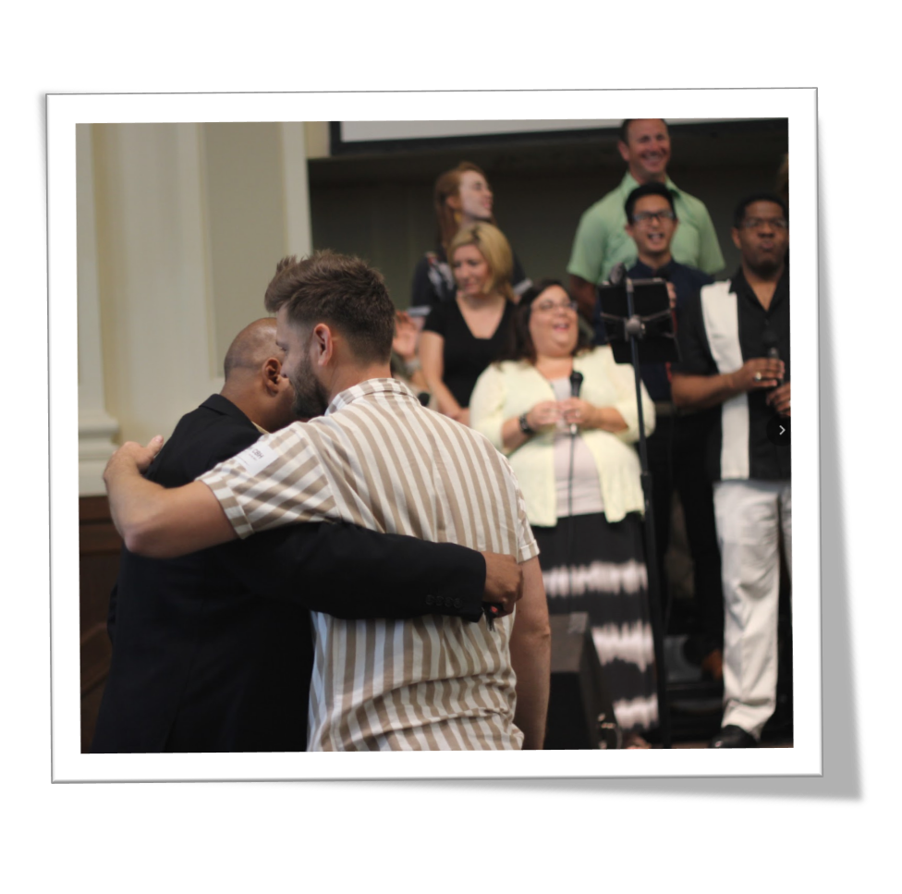
V. Salute!
Greet!
Hug your pastor, ministry leader, discipler, etc…
Hug everyone else!

Slide 19
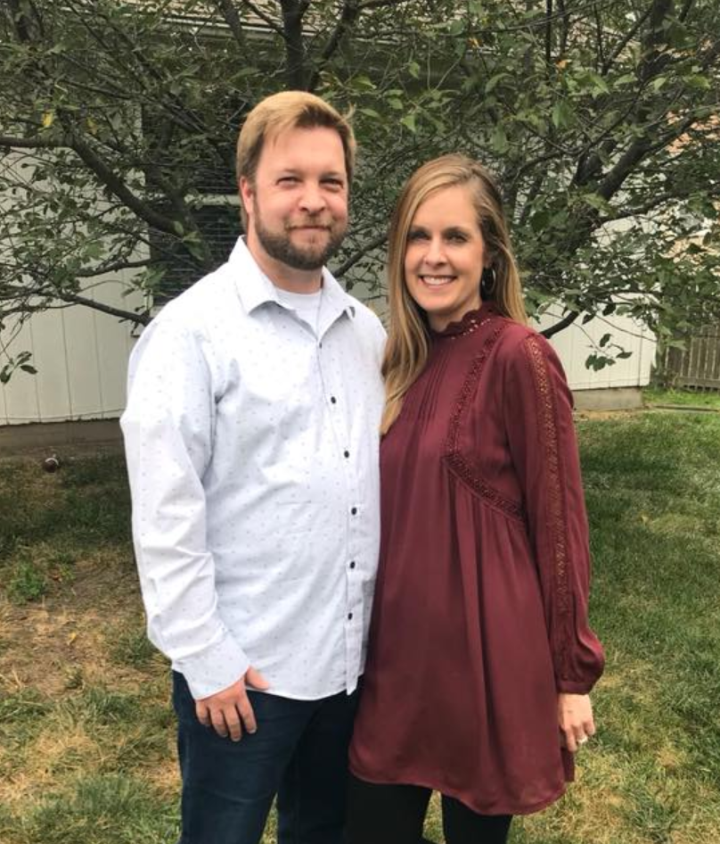
V. Salute Mike Reneau.

Slide 20
Hebrews 13
Pondering and Praying Over Our Pastors

